Slide 1
QUADRATIC FUNCTIONS
From Graph to Equation
Decoding parabolas using vertex, intercept, and standard algebraic forms.

Slide 2


CORE CONCEPTS
The Three Primary Forms
Standard Form
Vertex Form
Intercept Form
General algebraic baseline.
Prioritizes minimum/maximum.
Focuses on x-axis crossings.

Slide 3

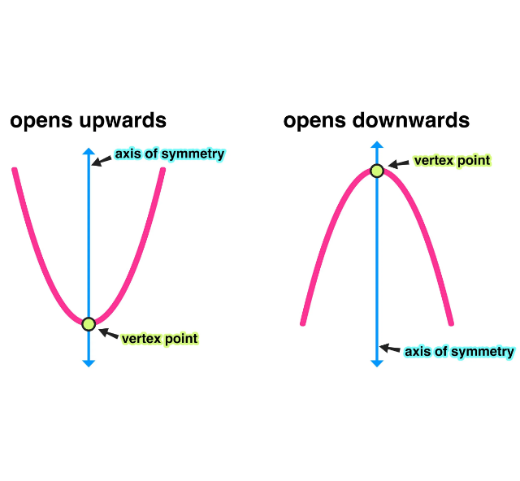
METHOD 01
The Vertex Form
Clear turning point: Locatable minimum or maximum.
Required data: One additional random point.
Geometric pivot: Defines the axis of symmetry directly.

Slide 4
PROCESS
Applying Vertex Form
1
2
3
4
Identify Vertex
Substitute Values
Select Point
Compute Factor
Extract exact (h, k) coordinates.
Plug directly into base equation.
Find another distinct curve intersection.
Solve algebraically for stretch factor.

Slide 5





WORKED EXAMPLE
Vertex Form in Action
1
Base structure
2
Insert vertex
GIVEN VERTEX (H, K)
3
Insert target point
(2, -3)
4
Solve for factor a
GIVEN POINT (X, Y)
(4, 5)
Final Equation

Slide 6
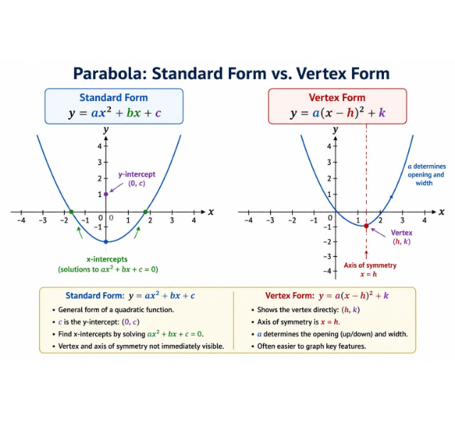
METHOD 02
The Intercept Form
Visible crossings: Parabola perfectly hits x-axis marks.
Direct root application: Use coordinates immediately.
Y-intercept utility: Often provides the required third point.

Slide 7


PROCESS
Applying Intercept Form
Locate Roots
Build Base Format
Find precise (p, 0) and (q, 0) intercepts.
Write algebraic factored structure.
Select Third Point
Compute Final Scale
Choose y-intercept or defined coordinate.
Solve equation to isolate magnitude.

Slide 8
WORKED EXAMPLE
Intercept Form in Action
1
Base structure
2
Insert root values
GIVEN ROOTS (P, Q)
3
Insert y-intercept
x = -1 & x = 3
4
Solve for factor a
GIVEN Y-INTERCEPT
(0, -6)
Final Equation

Slide 9
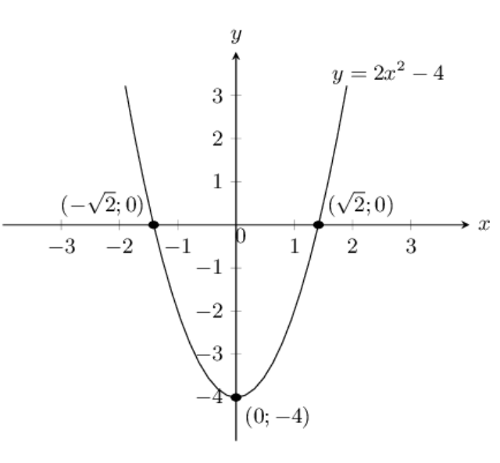
METHOD 03
The Standard Form
No visible vertex: Peak falls between grid lines.
No clear roots: Crossings lack integer coordinates.
Three distinct points: Requires system of three equations.

Slide 10
The Universal Variable
a
The Stretch Factor
Dictates parabola width and absolute vertical direction across all equation variants.

Slide 11



DECISION LOGIC
Choosing the Right Path
Visible Vertex
Visible Roots
Three Coordinates
Implement Vertex Form directly.
Implement Intercept Form directly.
Implement Standard Form algebraically.

Slide 12
Mastering the Parabola
Questions & Review

Slide 13



Image Sources
https://images.squarespace-cdn.com/content/v1/54905286e4b050812345644c/3613e53e-4a48-46f0-bc0f-2cb84a68b9f2/Vertex-Graphic.jpg
Source: www.mashupmath.com
https://conceptviz.app/images/tools/parabola-graph-generator/parabola-standard-vs-vertex.webp
Source: conceptviz.app
https://www.siyavula.com/read/za/mathematics/grade-10/functions/images/67e1f7292a65ec49c1b85a25c2479edb.png
Source: www.siyavula.com

